Slide 1
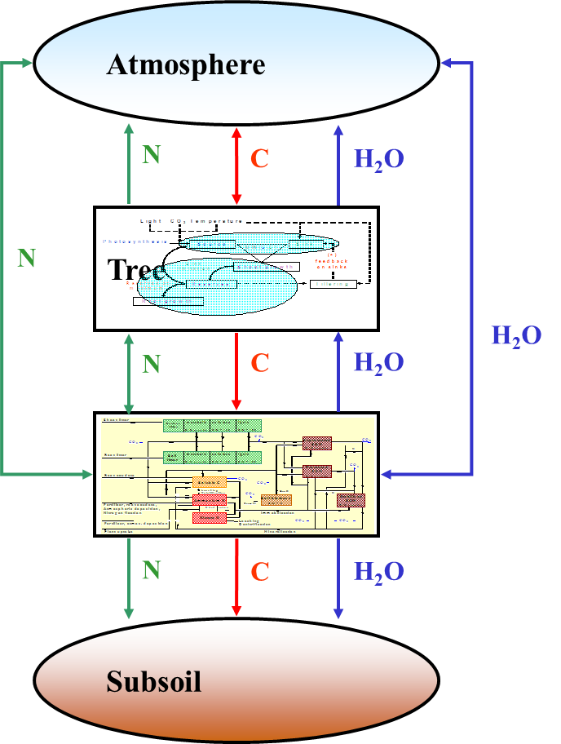
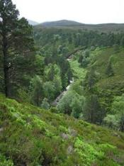
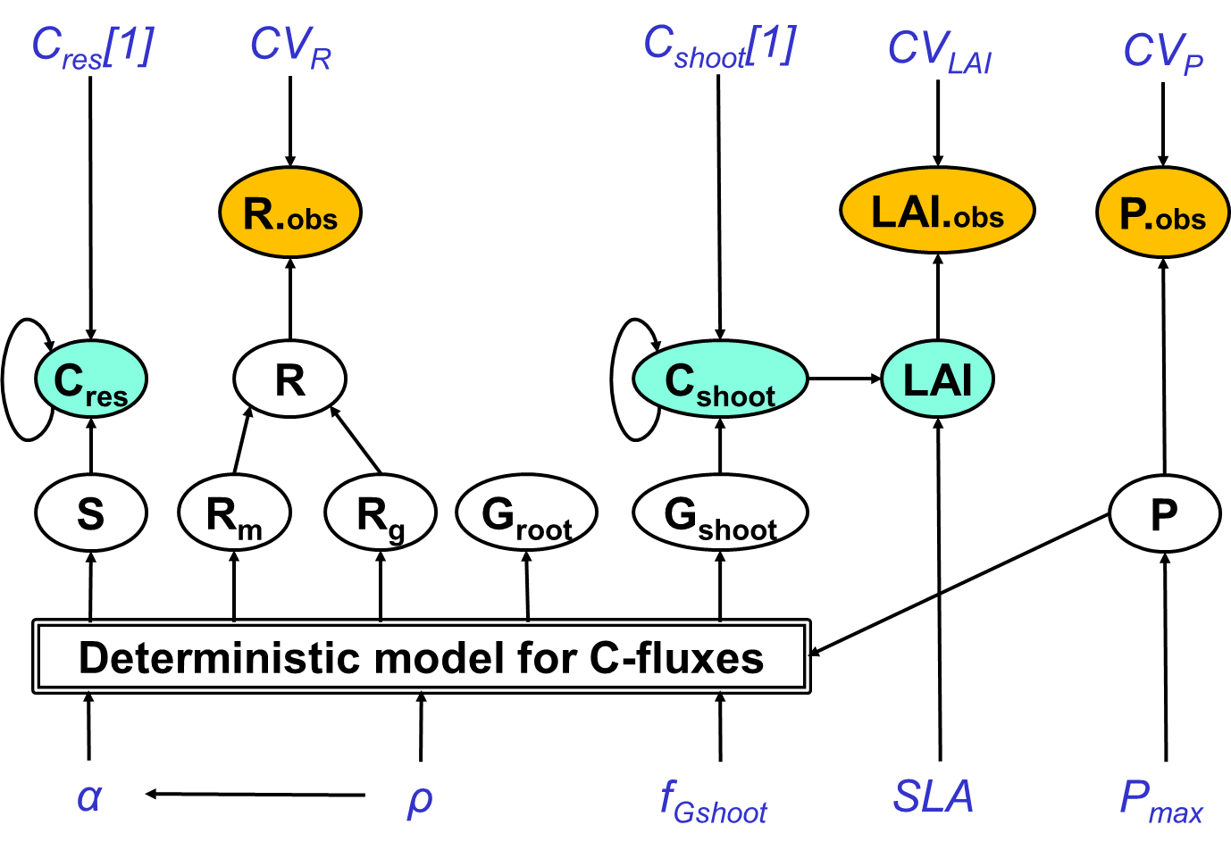
Bayesian Methods for Ecological and Environmental Modelling: SOFTWARE, FUTURE BAYES et al.
Marcel van Oijen
CEH-Edinburgh, 2019-09-13

Slide 2
Contents
Software alternatives
Future use of Bayesian methods
Group discussions

Slide 3
1. Software alternatives
1.1 BUGS
1.2 Nimble
1.3 Stan
1.4 GEM-SA & ExeterUQ
1.5 INLA

Slide 4
BUGS -> WinBUGS -> OpenBUGS
https://www.r-bloggers.com/a-primer-on-r2openbugs-using-the-simple-linear-regression-example/
library(R2OpenBUGS)
BCmodel <- function()
{ for (i in 1:N) {
y[i] ~ dnorm(mu[i], precision[i])
mu[i] <- intercept + slope * t[i]
precision[i] <- 1 / (sigma[i]*sigma[i])
}
# Marginal priors:
intercept ~ dunif(0, 10)
slope ~ dunif(0, 1)
}
write.model( BCmodel, "BCmodel.txt" )
BCdata <- list( t = c(10 , 20 , 30 ),
y = c( 6.09, 8.81, 10.66),
sigma = c( 1.83, 2.64, 3.27),
N = 3 )
BCinits <- function() { list( intercept = 5, slope = 0.5 ) }
BCout <- bugs( BCdata,
BCinits,
c("intercept","slope"),
"BCmodel.txt",
n.chains=1,
n.iter =5000,
DIC=F)

Slide 5
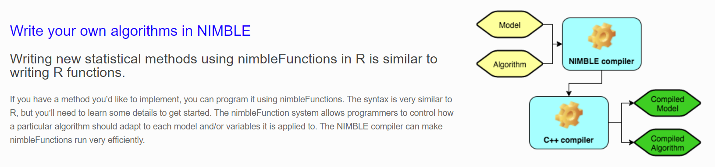
Nimble
NIMBLE stands for Numerical Inference for statistical Models for Bayesian and Likelihood Estimation.
https://r-nimble.org/html_manual/cha-welcome-nimble.html
Model specification as in BUGS and JAGS
MCMC different

Slide 6
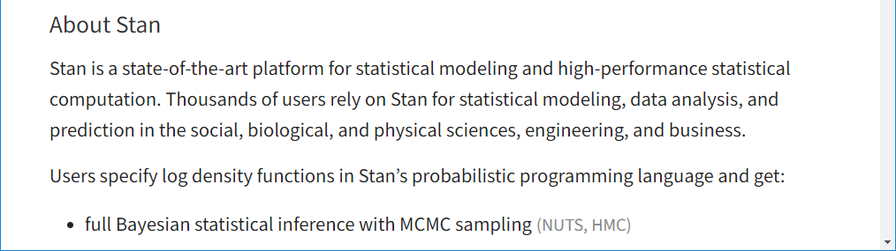
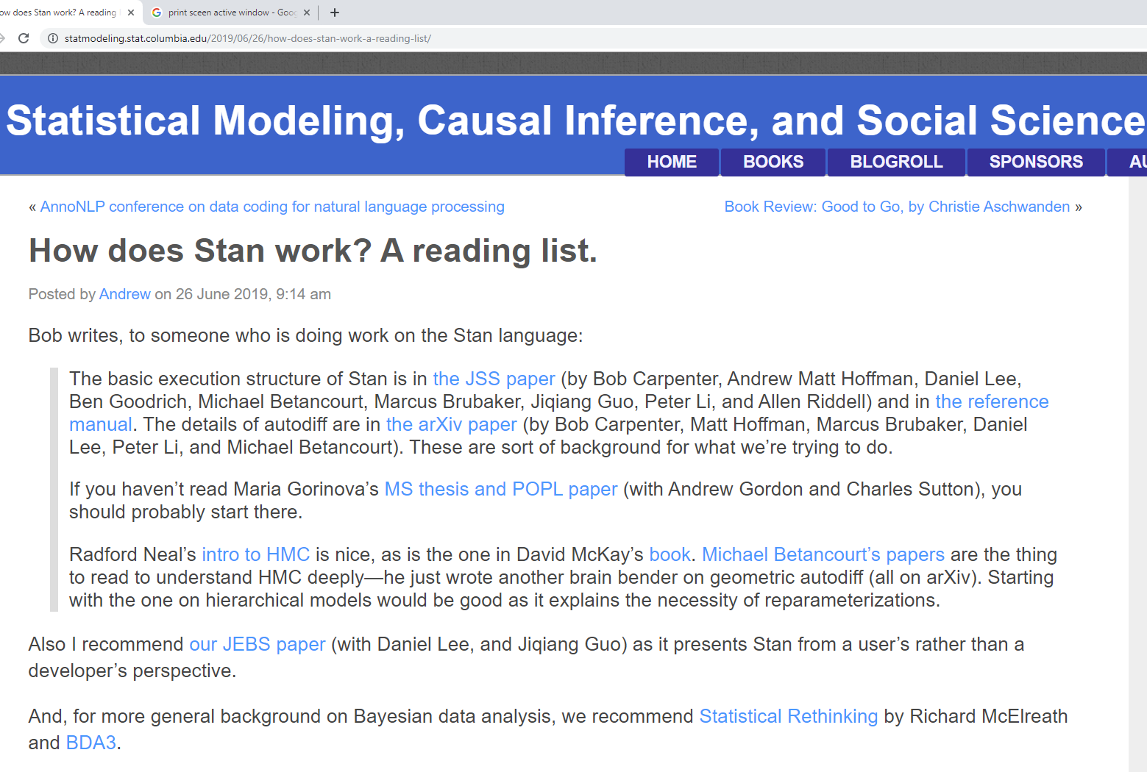
Stan: https://mc-stan.org/

Slide 7
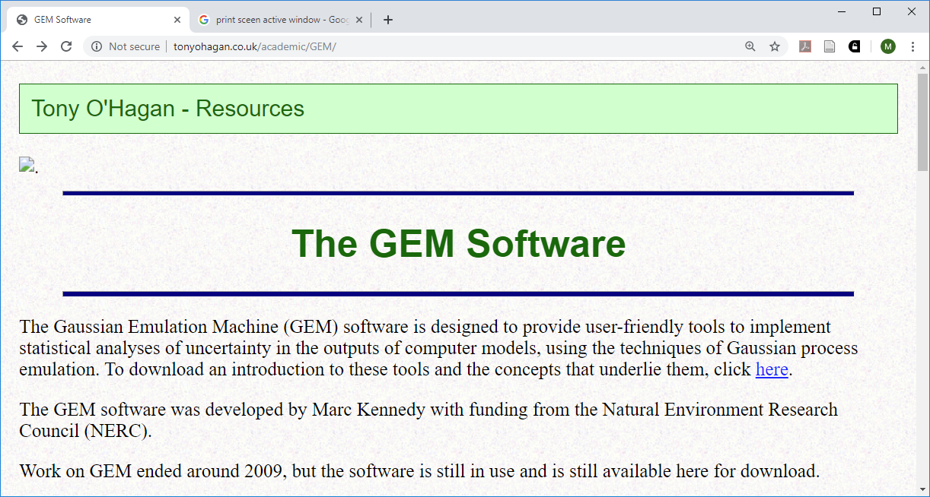
GEM-SA & ExeterUQ
GEM-SA
ExeterUQ: papers and GitHub repository in prep. (Williamson & Volodina)

Slide 8
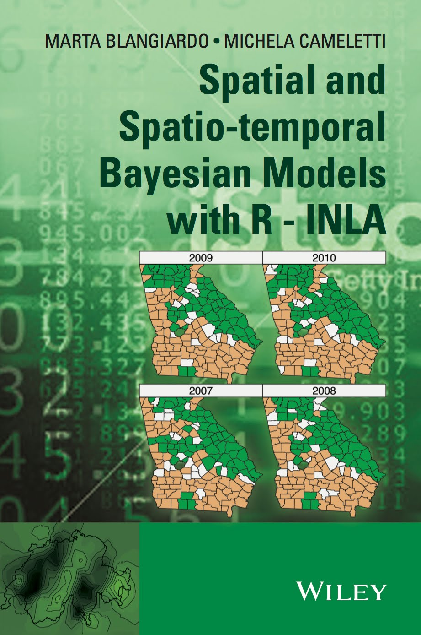
INLA: R-INLA & inlabru
Integrated Nested Laplace Approximation
http://www.r-inla.org/
https://sites.google.com/inlabru.org/inlabru
R-package 'INLA'
R-package 'inlabru'

Slide 9
2. Future use of Bayesian methods

Slide 10
Trends in the use of probabilistic methods?
Van Oijen (2017). Curr. Forestry Rep.

Slide 11
Model comparison
Science (1890)
"
"

Slide 12
Model comparison
"he ensemble mean often outperforms all or almost all of the ensemble members" (Rougier 2016, J. Clim.)
Comp. internal and external discrepancy (Goldstein)
obs.
(Van Oijen et al. 2013, For. Ecol. Man.)
(2013, Phil. Trans. R.S.)

Slide 13
Trends in the use of probabilistic methods?
Managing uncertainty in complex models is a huge topic:
Uncertainty about errors in model drivers, parameters and structure
Emulation, pre-calibration, calibration, prediction
ExeterUQ: new software for pre-calibration and emulation of complex models (Volodina, Williamson et al.)
Other Bayesian software for complex models: PEcAn (Dietze et al. 2013), BayesianTools (Hartig et al 2017.), NIMBLE (de Valpine et al. 2017).
Emulation is becoming increasingly powerful:
Bayesian hierarchical emulation for multivariate spatiotemporal input and output (Oyebamiji)

Slide 14
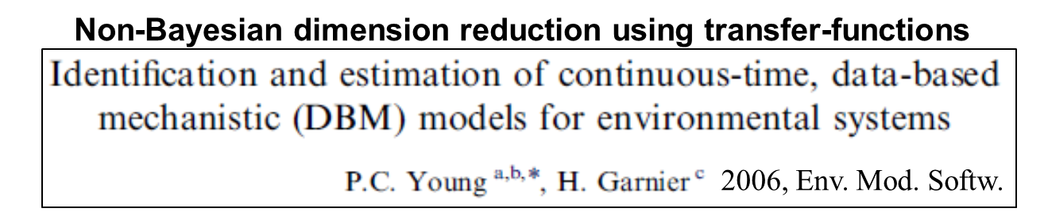
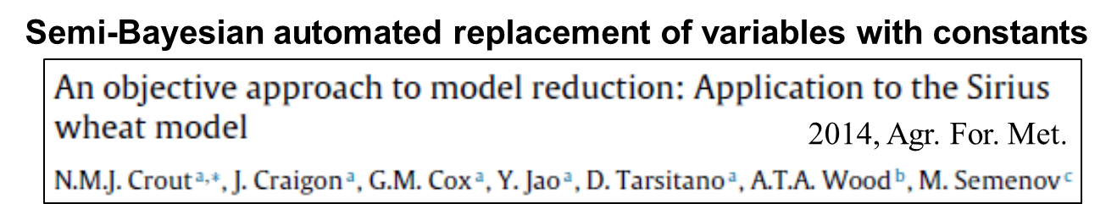
Trends in the use of probabilistic methods?
Alternatives to emulation: different methods for model simplification
Compare MaxEnt approach (Dewar): have no unneeded mechanisms in your model

Slide 15
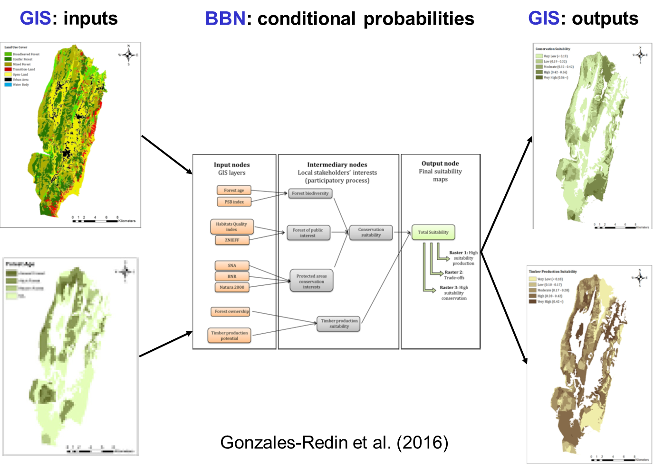
Trends in the use of probabilistic methods?
Freeman & Spiegelhalter
(Winton Centre for Risk and Evidence Communication)
Using GIS + BBN to optimise land-use: conservation vs. production.
Accounting for uncertainties
Stakeholder involvement

Slide 16
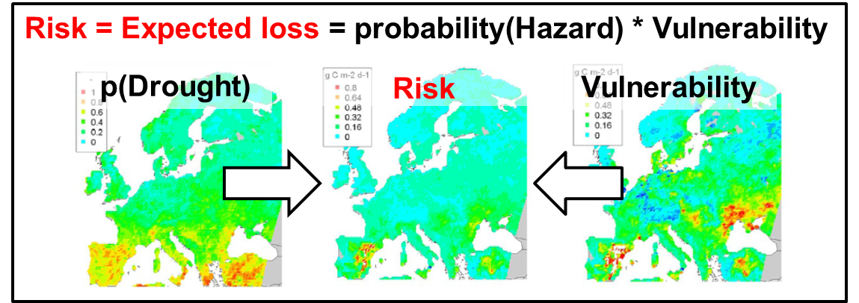
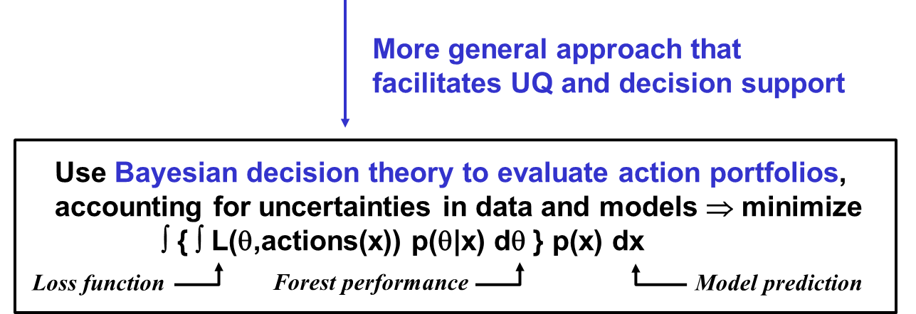
Trends in the use of probabilistic methods?

Slide 17
Trends in the use of probabilistic methods?
Bayesian meta-analysis (Spake, Stewart)
Model diagnostics & design
Machine learning

Slide 18
Adaptive sampling as a ST learning process

Slide 19
Adaptive sampling (after Wikle & Royle 1999)
Model: spatiotemporal, a combination of kriging and Kalman filter
Field: 49 potential sensor locations at each time step
Spatial and temporal correlations assumed constant and known
Design (sensor placement in space): adaptive, based on measurement history
Design criterion: put the sensor at the location that minimises the average prediction variance (i.e. the mean of the 49 kriging variances)
OPTIMAL DESIGN: Start at centre, move to other locations immediately

Slide 20
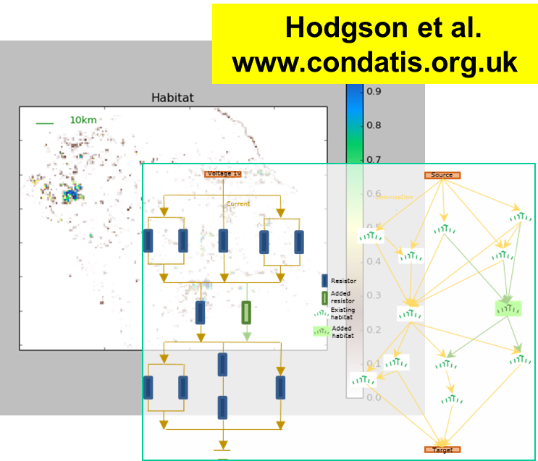
Can probability theory help in diagnosis & design?
Designing monitoring programmes, adaptive sampling
Deisgning landscapes to stimulate ecological processes
Designing models, diagnosing model weaknesses
Decomposing mean-squared difference (MSD) between a modelled and measured time series (Kobayashi & Salam 2000, van Oijen et al. 2011)
MSD =
Difference
Mean
Variance
Phase
Linked state variable missing?
Error
Process missing?
Feedback missing?

Slide 21
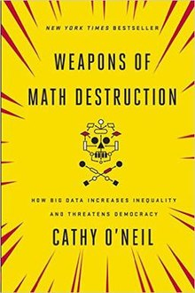
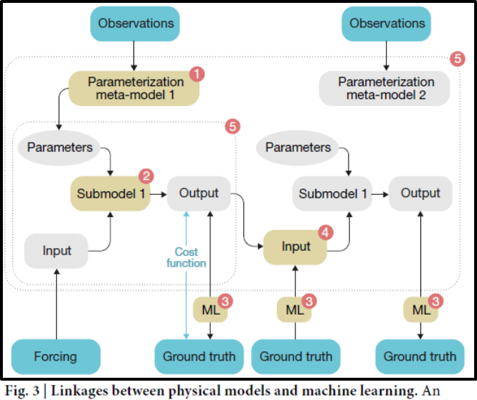
The lure of ML
Mentioned in bullet-points of many talks but rarely discussed in detail
ML is rooted in standard statistical techniques (PCA, cluster analysis, stepwise regression, variable selection, Bayesian networks, ...), but has become more powerful computationally and algorithmically
Dangers of using black-box algorithms in decision-making (O'Neill 2016)
How can we combine mechanistic understanding with automated pattern recognition?
Reichstein et al. (2019, Nature).

Slide 22
Bayesian science
Research question
In environmental sciences …
f is often a big, slow process-based model
P(ϑ) is multivariate
D: big data
Bayesian updating requires numerical methods such as MCMC
Formulate model
y = f(x;ϑ)
Get new information
Assess information
P(ϑ)
new data (D)
Calculate
likelihood
Update probability distrib.
P(ϑ|D)
P(D|ϑ)
Apply model
Provisional answer

